Slide 1


LIGHT — REFLECTION
AND REFRACTION
Class X · CBSE Physics · Chapter 9
- Shubhranshu Sahu

Slide 2

Let's Rewind and Recall
What you already know
Light travels in straight lines
Rectilinear propagation; speed in air/vacuum ≈ 3 × 10⁸ m/s.
Reflection from a plane mirror
Bouncing back of light into the same medium.
A shiny surface forms an image
Plane mirror → virtual, erect, same-size, laterally inverted image.
What this chapter adds
• Spherical mirrors — concave & convex
• Ray diagrams & the 6 image cases
• Mirror formula & magnification
• Refraction & refractive index
• Lenses — convex & concave, lens formula
• Power of a lens (dioptre)
Sign convention & formulae make numericals easy — master them early.

Slide 3
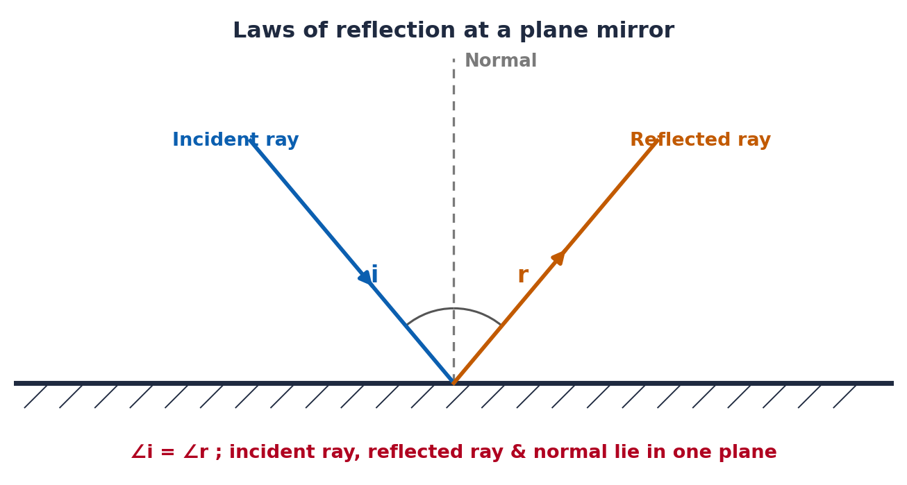
Reflection of Light & Its Laws
Two laws of reflection
Law 1
Angle of incidence = angle of reflection (∠i = ∠r).
Law 2
The incident ray, the reflected ray and the normal at the point of incidence all lie in the same plane.
Reflection: light bounces back into the same medium.

Slide 4
Image Formed by a Plane Mirror
Characteristics
• Virtual and erect — cannot be caught on a screen; upright.
• Same size — image size = object size.
• Behind the mirror — image distance = object distance.
• Laterally inverted — left ↔ right interchanged.
Lateral inversion
The word AMBULANCE is written reversed on vehicles so it reads correctly in a driver's rear-view mirror.
Important Result:
A plane mirror always forms a virtual, erect image of the same size, as far behind the mirror as the object is in front.

Slide 5
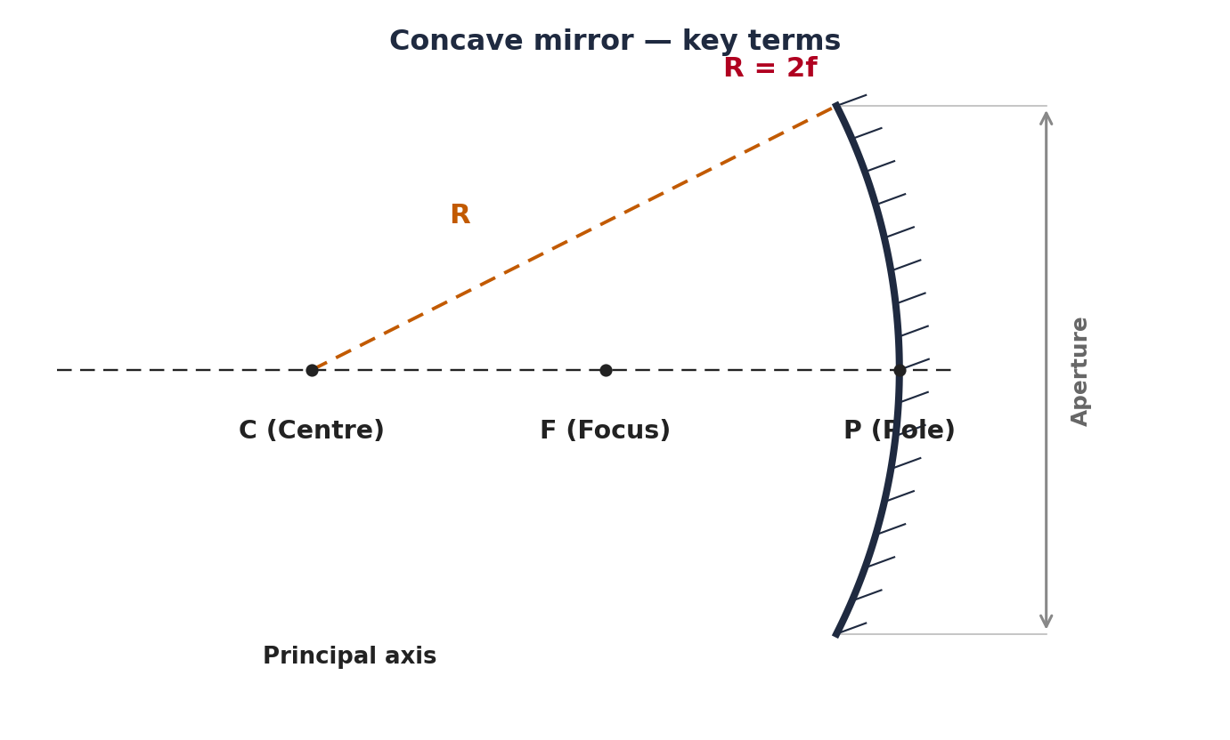
Spherical Mirrors — Key Terms
Definitions
Pole (P): centre of the mirror surface.
Centre of curvature (C): centre of the sphere the mirror is part of.
Radius of curvature (R): distance PC.
Principal focus (F): where rays parallel to the axis meet (concave) or appear to diverge from (convex).
Focal length (f): distance PF.
R = 2f

Slide 6
Rules for Drawing Ray Diagrams
For spherical mirrors
1. A ray parallel to the principal axis passes through F after reflection.
2. A ray through F becomes parallel to the principal axis.
3. A ray through C retraces its path (hits normally).
4. A ray striking the pole reflects making equal angles with the axis.
Two types
Concave (converging)
Reflecting surface curves inward; converges parallel light to a real focus.
Convex (diverging)
Reflecting surface bulges outward; diverges parallel light (virtual focus).
Any two rays are enough to locate the image.

Slide 7
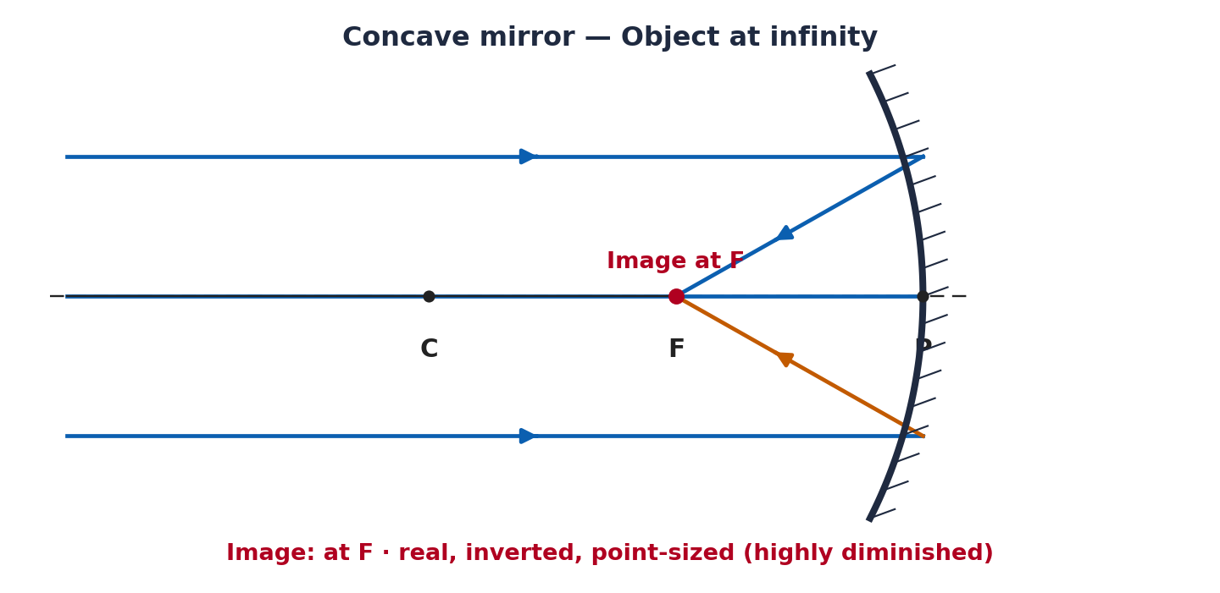
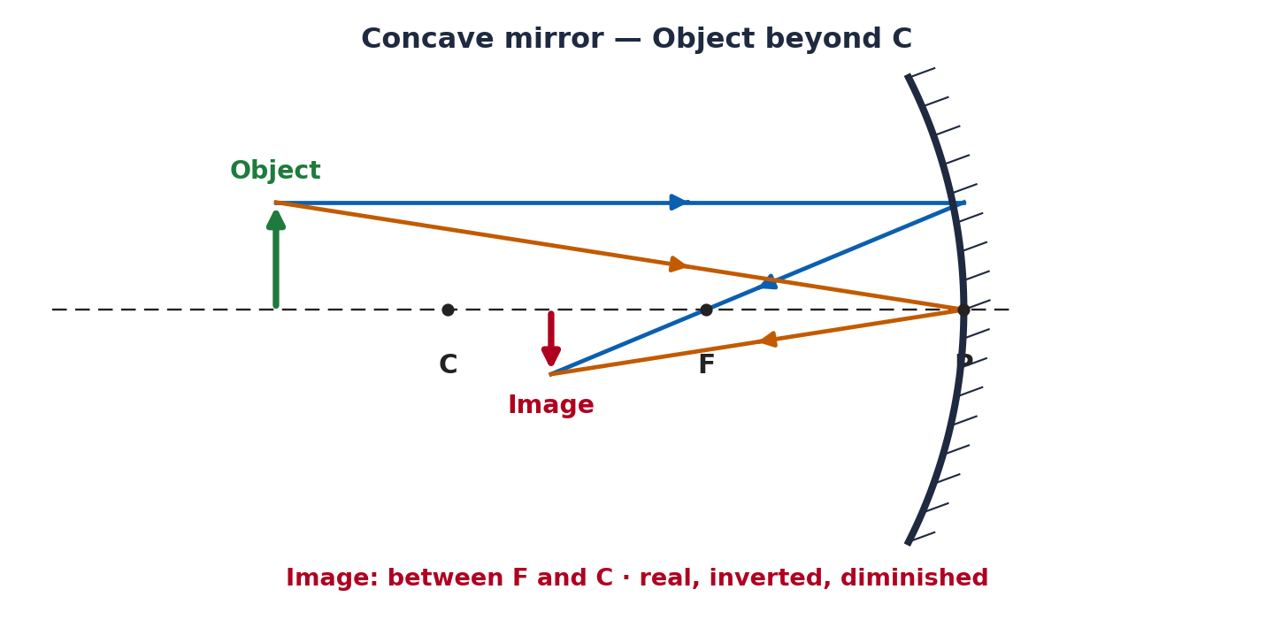
Concave Mirror — Image Formation (1)

Slide 8
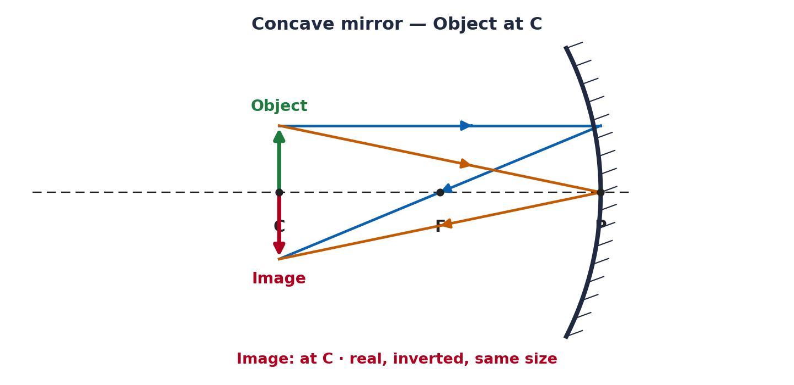
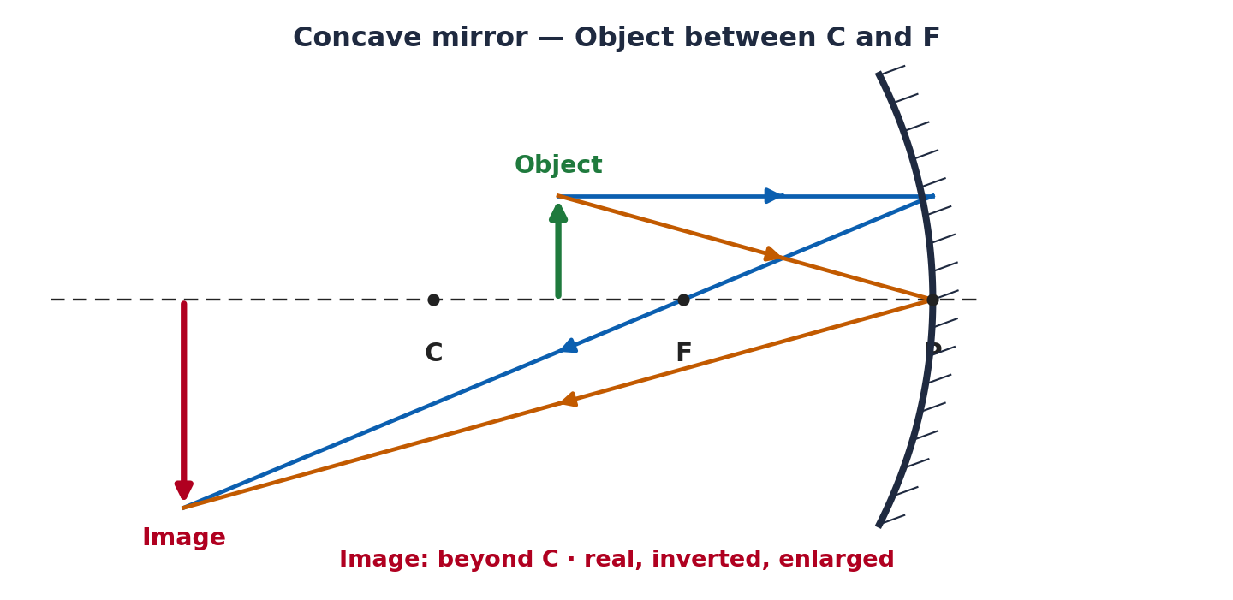
Concave Mirror — Image Formation (2)

Slide 9
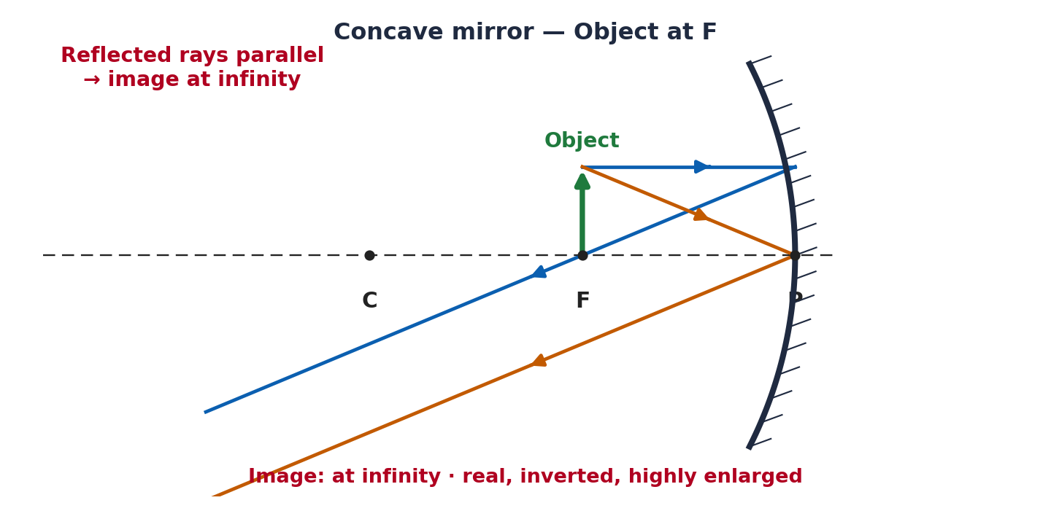
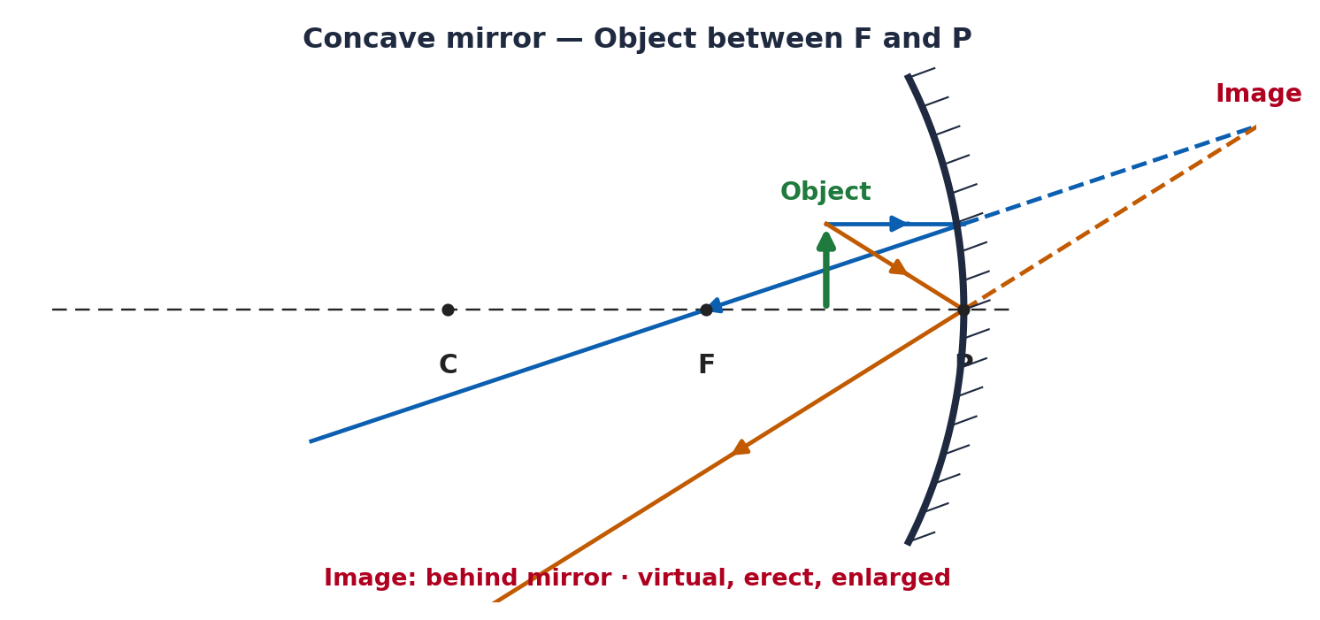
Concave Mirror — Image Formation (3)

Slide 10
Concave Mirror — Summary of Cases
Position of object | Position of image | Size | Nature
At infinity | At F | Point-sized | Real, inverted
Beyond C | Between F and C | Diminished | Real, inverted
At C | At C | Same size | Real, inverted
Between C and F | Beyond C | Enlarged | Real, inverted
At F | At infinity | Highly enlarged | Real, inverted
Between F and P | Behind the mirror | Enlarged | Virtual, erect

Slide 11
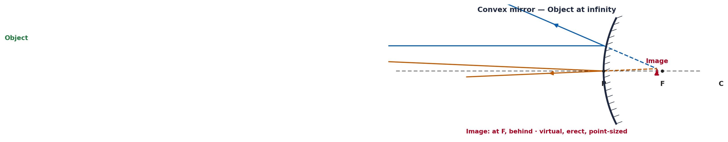
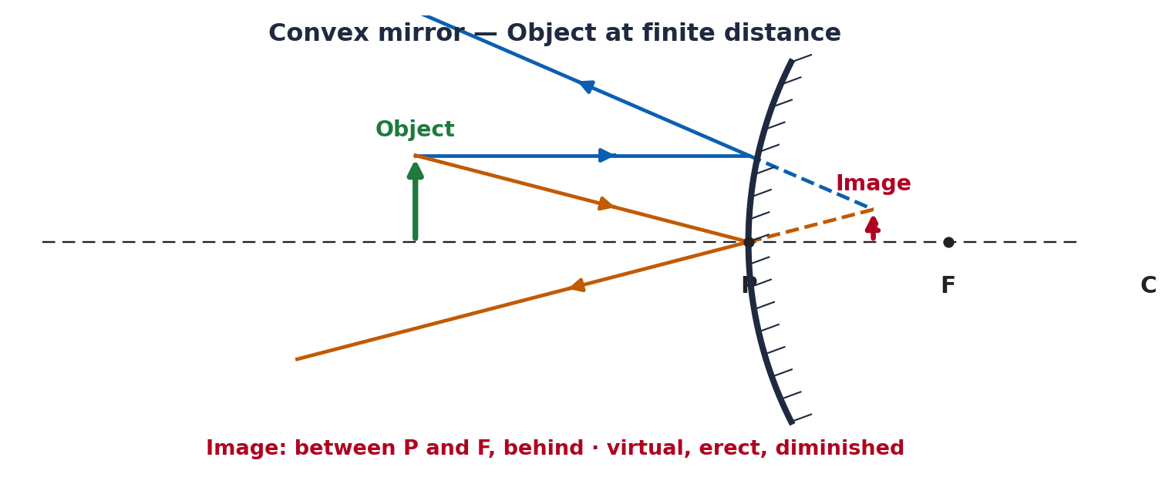
Convex Mirror — Image Formation

Slide 12
Uses of Spherical Mirrors
Concave mirror
• Shaving & make-up mirrors (enlarged erect image when face is close).
• Dentists' mirrors to see enlarged teeth.
• Reflectors in torches, headlights & searchlights (source at F → parallel beam).
• Solar furnaces to concentrate sunlight.
Convex mirror
• Rear-view (wing) mirrors in vehicles.
• They give an erect, diminished image and a wider field of view.
• Used on blind turns and in big stores for security surveillance.
• Street-light reflectors to spread light over a large area.

Slide 13
New Cartesian Sign Convention
The rules
• The pole (P) / optical centre (O) is the origin.
• All distances are measured from P (or O).
• Distances measured along the incident light (to the right) are +ve; against it (to the left) are −ve.
• Heights above the principal axis are +ve; below are −ve.
What it means
Object distance u
Always −ve (object is in front, to the left).
Focal length f
Concave mirror & convex lens: −ve / +ve respectively; convex mirror & concave lens: +ve / −ve.
Important Result:
Put signs in FIRST, then solve — most numerical errors are sign slips.

Slide 14
Mirror Formula & Magnification
Mirror formula
1/v + 1/u = 1/f
v = image distance, u = object distance, f = focal length.
R = 2f
Links radius of curvature to focal length.
Magnification
m = h′/h = −v/u
h′ = image height, h = object height.
Reading the sign
m −ve → real & inverted image; m +ve → virtual & erect image. |m| > 1 enlarged, < 1 diminished.

Slide 15
Worked Example — Concave Mirror
Problem
An object is placed 15 cm from a concave mirror of focal length 10 cm. Find the image position, magnification and nature.
Solution
u = −15 cm, f = −10 cm
1/v = 1/f − 1/u = −1/10 + 1/15 = −1/30
v = −30 cm
m = −v/u = −(−30)/(−15) = −2
Image: 30 cm in front, real, inverted, twice the size (enlarged).
Checkpoints
• Object between C and F (15 cm, with C = 20, F = 10).
• So image is beyond C — real, inverted, enlarged. ✓
• v is −ve → image in front (real). ✓
• m is −ve → inverted. ✓

Slide 16
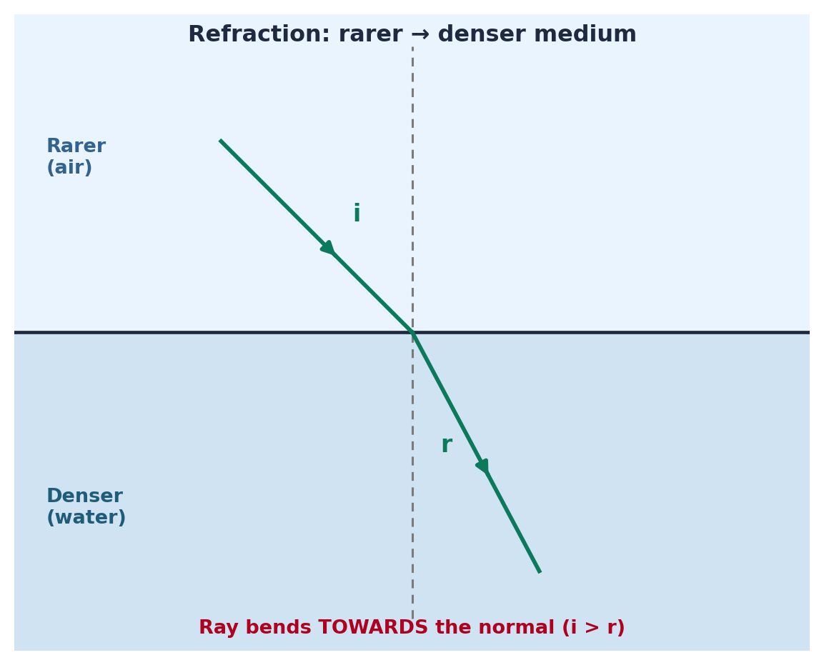
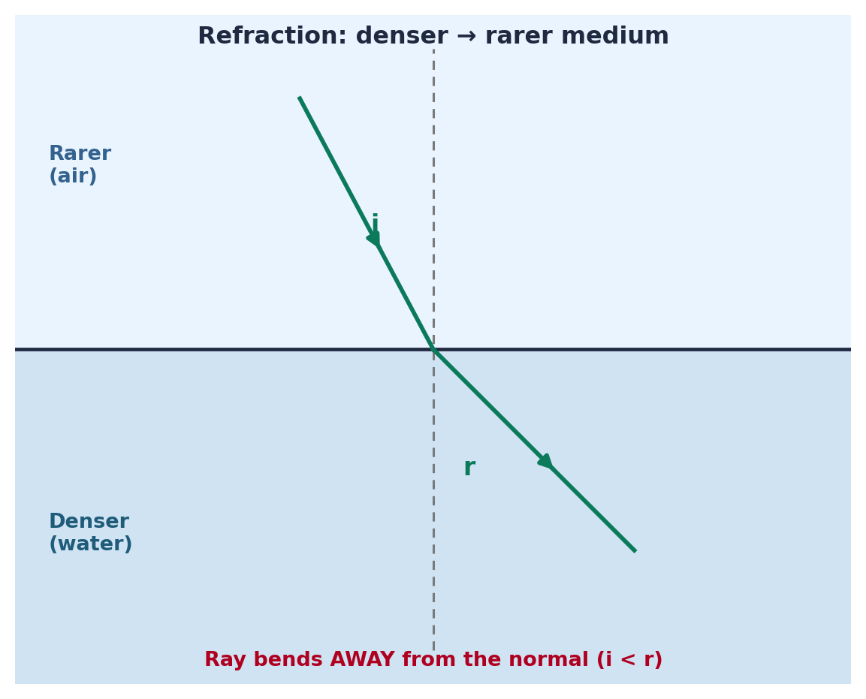
Refraction of Light
The rule
Rarer → denser: bends towards the normal.
Denser → rarer: bends away from the normal.
No bending if it hits along the normal (i = 0).

Slide 17
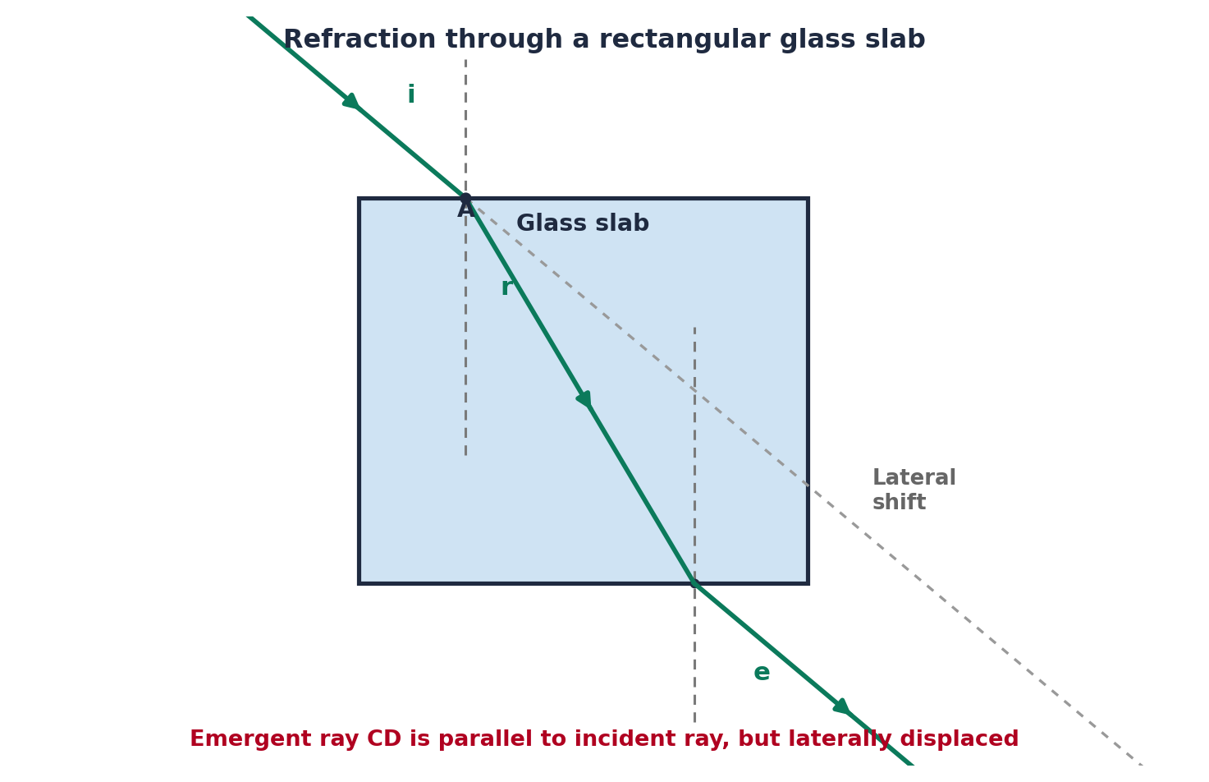
Refraction Through a Glass Slab
Key ideas
• Light bends towards the normal on entering glass (denser), and away on leaving.
• The emergent ray is parallel to the incident ray.
• It is shifted sideways — the lateral displacement.
Important Result:
Net bending is zero; only a sideways shift remains.

Slide 18
Laws of Refraction & Refractive Index
Laws of refraction
1. The incident ray, refracted ray and normal lie in the same plane.
2. Snell's law: sin i / sin r = constant.
sin i / sin r = n₂₁
Refractive index
n = c / v
c = speed of light in vacuum; v = speed in the medium.
Absolute refractive index
Medium | n
Air | 1.0003
Water | 1.33
Crown glass | 1.52
Diamond | 2.42
Higher n → optically denser → light travels slower. Kerosene (1.44) is optically denser than water (1.33).

Slide 19
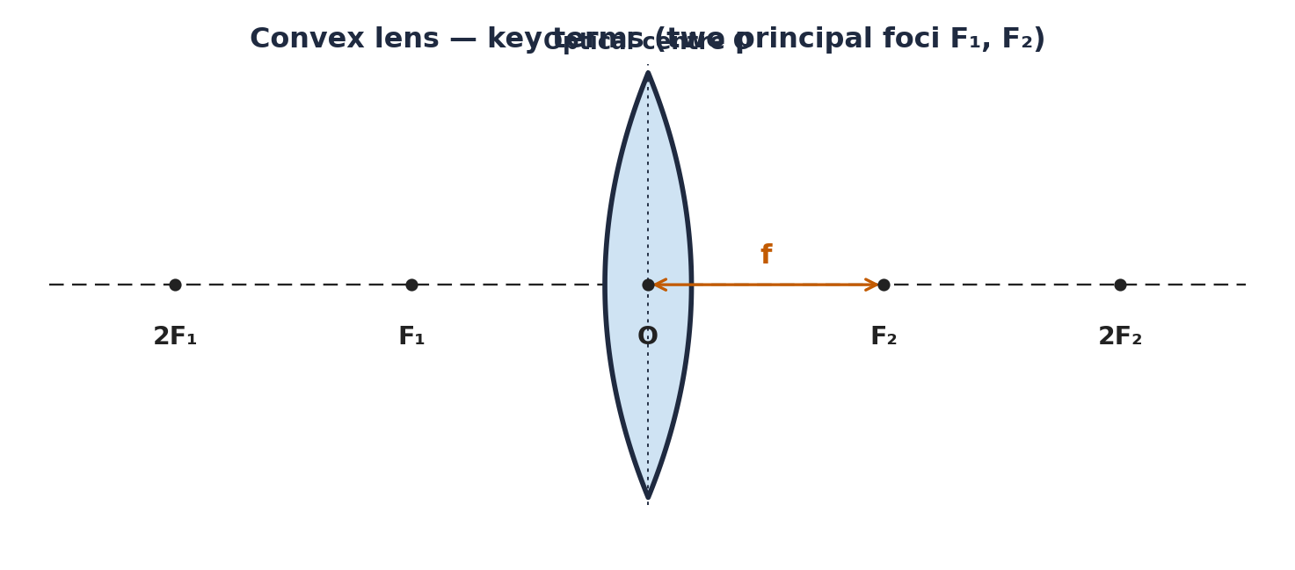
Spherical Lenses — Key Terms
Definitions
Optical centre (O): central point; a ray through it goes undeviated.
Principal axis: line through O and the centres of curvature.
Principal focus (F): a lens has two — one on each side.
Focal length (f): distance OF.
Convex = converging; Concave = diverging.

Slide 20
Rules for Image Formation by Lenses
Three rays
1. A ray parallel to the axis passes through the focus F₂ (convex) / appears to come from F₁ (concave).
2. A ray through the focus emerges parallel to the axis.
3. A ray through the optical centre O goes straight, undeviated.
Remember
• Convex lens: image real & inverted for objects beyond F; virtual & erect within F.
• Concave lens: image ALWAYS virtual, erect and diminished.
• Any two of the three rays locate the image.

Slide 21
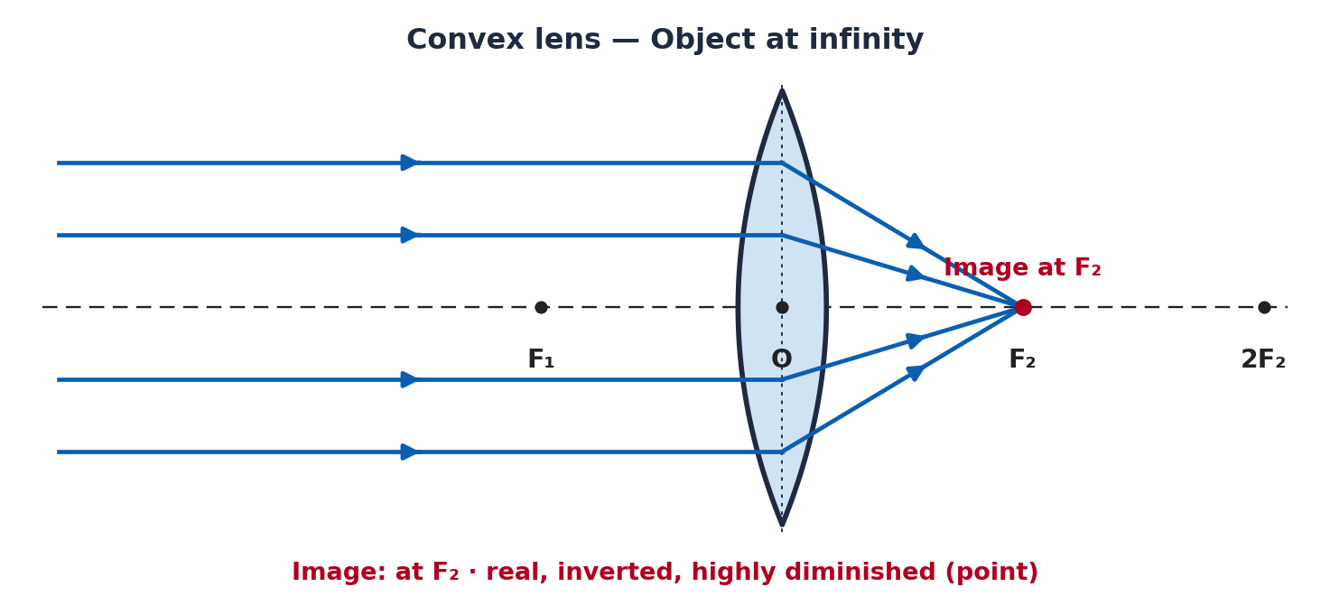
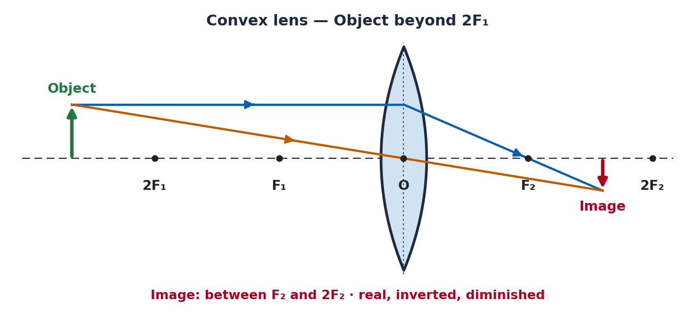
Convex Lens — Image Formation (1)

Slide 22
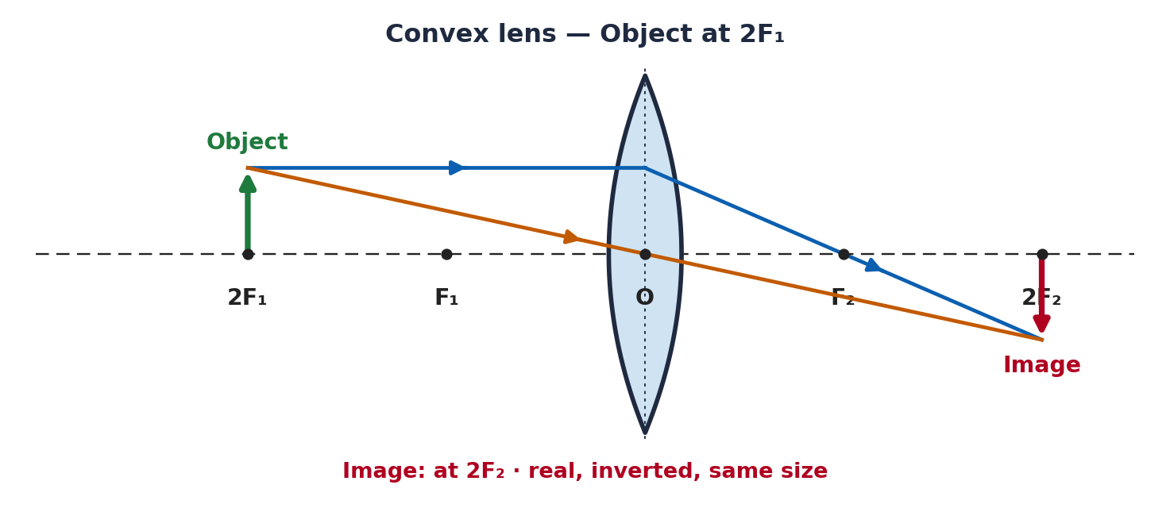
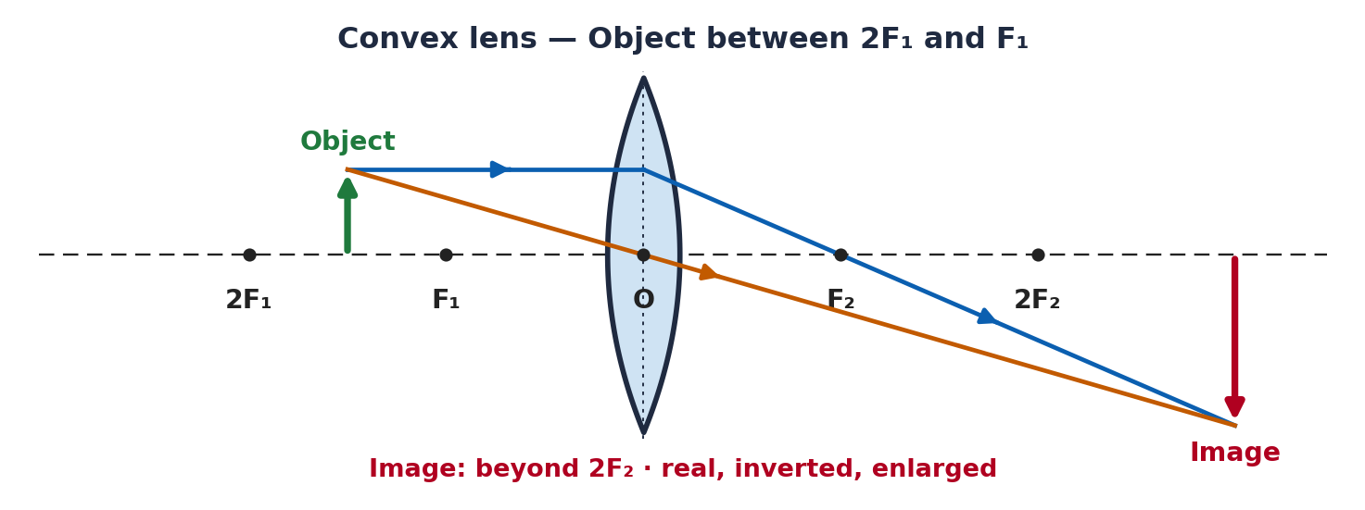
Convex Lens — Image Formation (2)

Slide 23
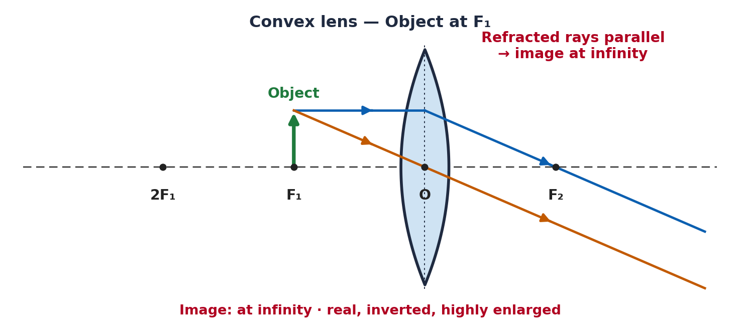
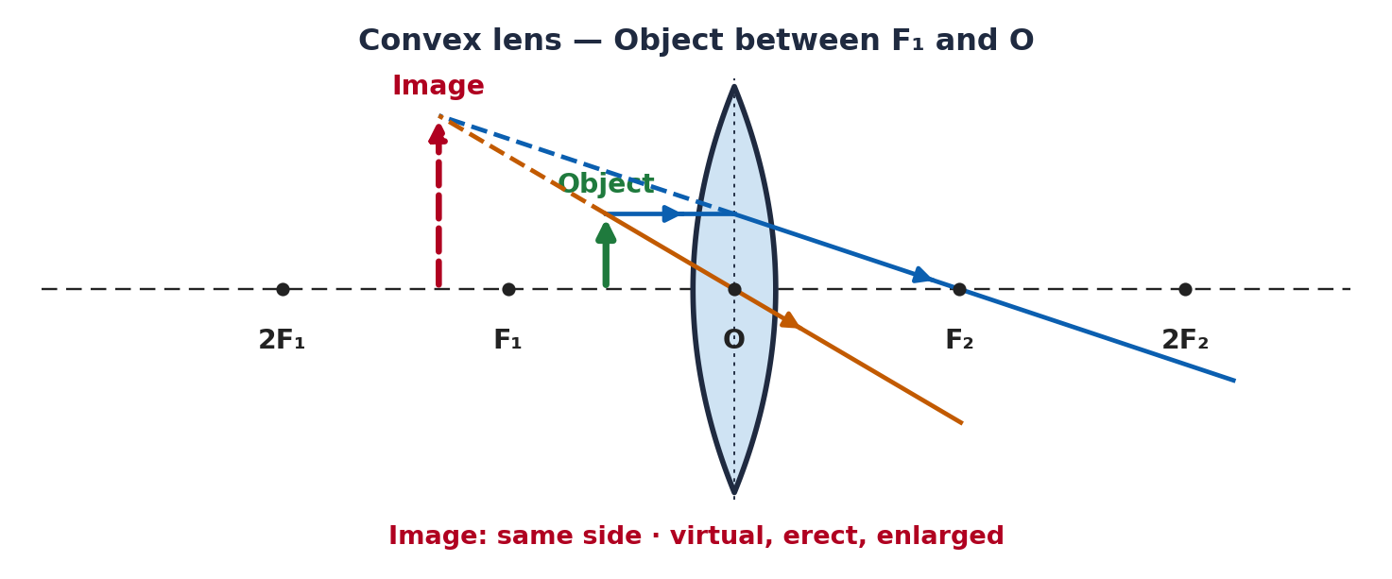
Convex Lens — Image Formation (3)

Slide 24
Convex Lens — Summary of Cases
Position of object | Position of image | Size | Nature
At infinity | At focus F₂ | Point-sized | Real, inverted
Beyond 2F₁ | Between F₂ and 2F₂ | Diminished | Real, inverted
At 2F₁ | At 2F₂ | Same size | Real, inverted
Between F₁ and 2F₁ | Beyond 2F₂ | Enlarged | Real, inverted
At focus F₁ | At infinity | Highly enlarged | Real, inverted
Between F₁ and O | Same side as object | Enlarged | Virtual, erect

Slide 25
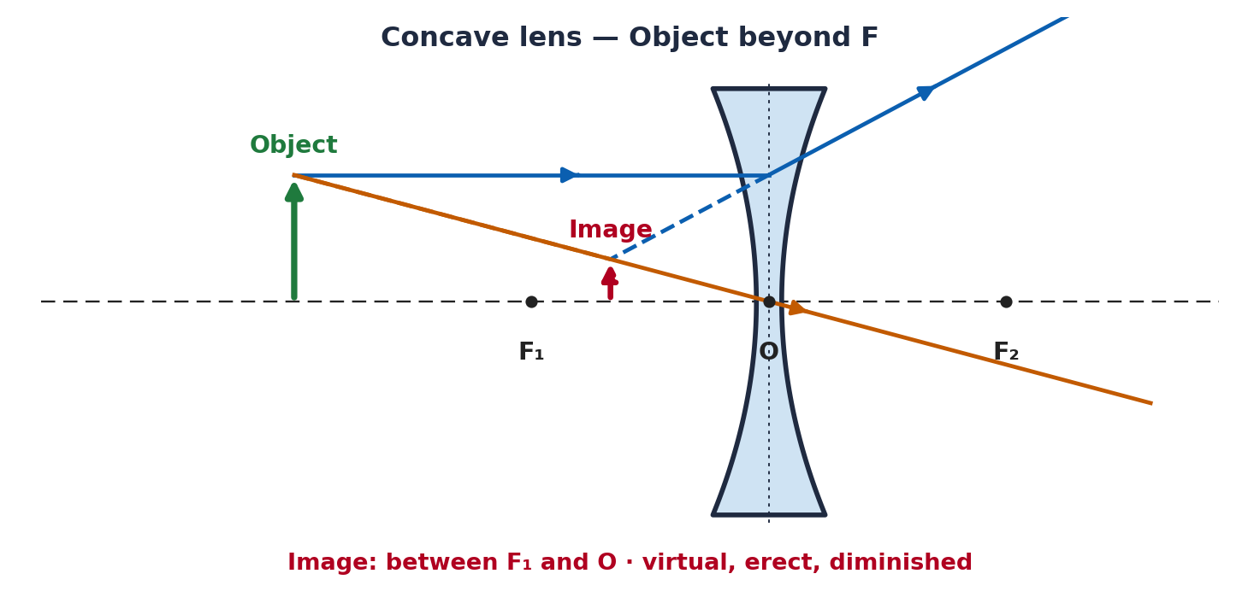
Concave Lens — Image Formation
Always the same
For every object position, a concave lens forms an image that is:
• Virtual and erect
• Diminished
• Between F₁ and the optical centre O, on the same side as the object.
Used in spectacles to correct myopia (short-sightedness).

Slide 26
Lens Formula & Magnification
Lens formula
1/v − 1/u = 1/f
Magnification
m = h′/h = v/u
Note the sign difference from the mirror formula (− vs +).
Sign convention (lenses)
• Convex lens: f is +ve.
• Concave lens: f is −ve.
• m +ve → virtual & erect; m −ve → real & inverted.
• Distances measured from the optical centre O.

Slide 27
Power of a Lens
Definition
P = 1 / f (f in metres)
SI unit: dioptre (D). 1 D = power of a lens of focal length 1 m.
Sign
Convex lens → +ve power; concave lens → −ve power.
Lenses in combination
P = P₁ + P₂ + P₃ + …
Powers of thin lenses in contact simply add.
Important Result:
A shorter focal length means a higher power (more converging/diverging).

Slide 28
Worked Example — Convex Lens
Problem
An object is placed 20 cm in front of a convex lens of focal length 10 cm. Find v, magnification and power.
Solution
u = −20 cm, f = +10 cm
1/v = 1/f + 1/u = 1/10 − 1/20 = 1/20
v = +20 cm
m = v/u = 20 / (−20) = −1
P = 1/f = 1/0.10 = +10 D
Image: 20 cm on the far side, real, inverted, same size.
Checkpoints
• Object at 2F₁ (20 cm) → image at 2F₂ (20 cm). ✓
• v +ve → real image on the opposite side. ✓
• m = −1 → inverted, same size. ✓

Slide 29
Important Results & Common Traps
Must-know results
• R = 2f for spherical mirrors.
• n = c/v; larger n → slower light, optically denser.
• Concave lens & convex mirror ALWAYS give virtual, erect, diminished images.
• Power P = 1/f(m), unit dioptre; powers add in contact.
Common traps
Trap 1 Mirror formula uses +, lens formula uses −. Don't mix them.
Trap 2 Apply signs BEFORE substituting, not after.
Trap 3 f in metres for power — 20 cm = 0.2 m → P = 5 D.
Trap 4 In a glass slab the ray is NOT reversed — it is shifted.

Slide 30
60-Second Recall & Quick-Fire
60-Second Recall
• ∠i = ∠r (reflection); sin i / sin r = n (refraction).
• R = 2f. Mirror: 1/v + 1/u = 1/f. Lens: 1/v − 1/u = 1/f.
• m = −v/u (mirror); m = v/u (lens).
• Concave mirror / convex lens can give real or virtual images.
• Convex mirror / concave lens → always virtual, erect, small.
• P = 1/f (m), in dioptre (D).
Quick-Fire Questions
1. Which mirror is used as a car rear-view mirror?
2. Where is the image when an object is at C of a concave mirror?
3. State the unit of power of a lens.
4. A lens has f = −25 cm. Find its power.
5. Speed of light in glass (n = 1.5)?
Answers: 1) convex 2) at C, real inverted same-size 3) dioptre
4) −4 D 5) 2 × 10⁸ m/s

Slide 31
THANK
YOU

